Slide 1
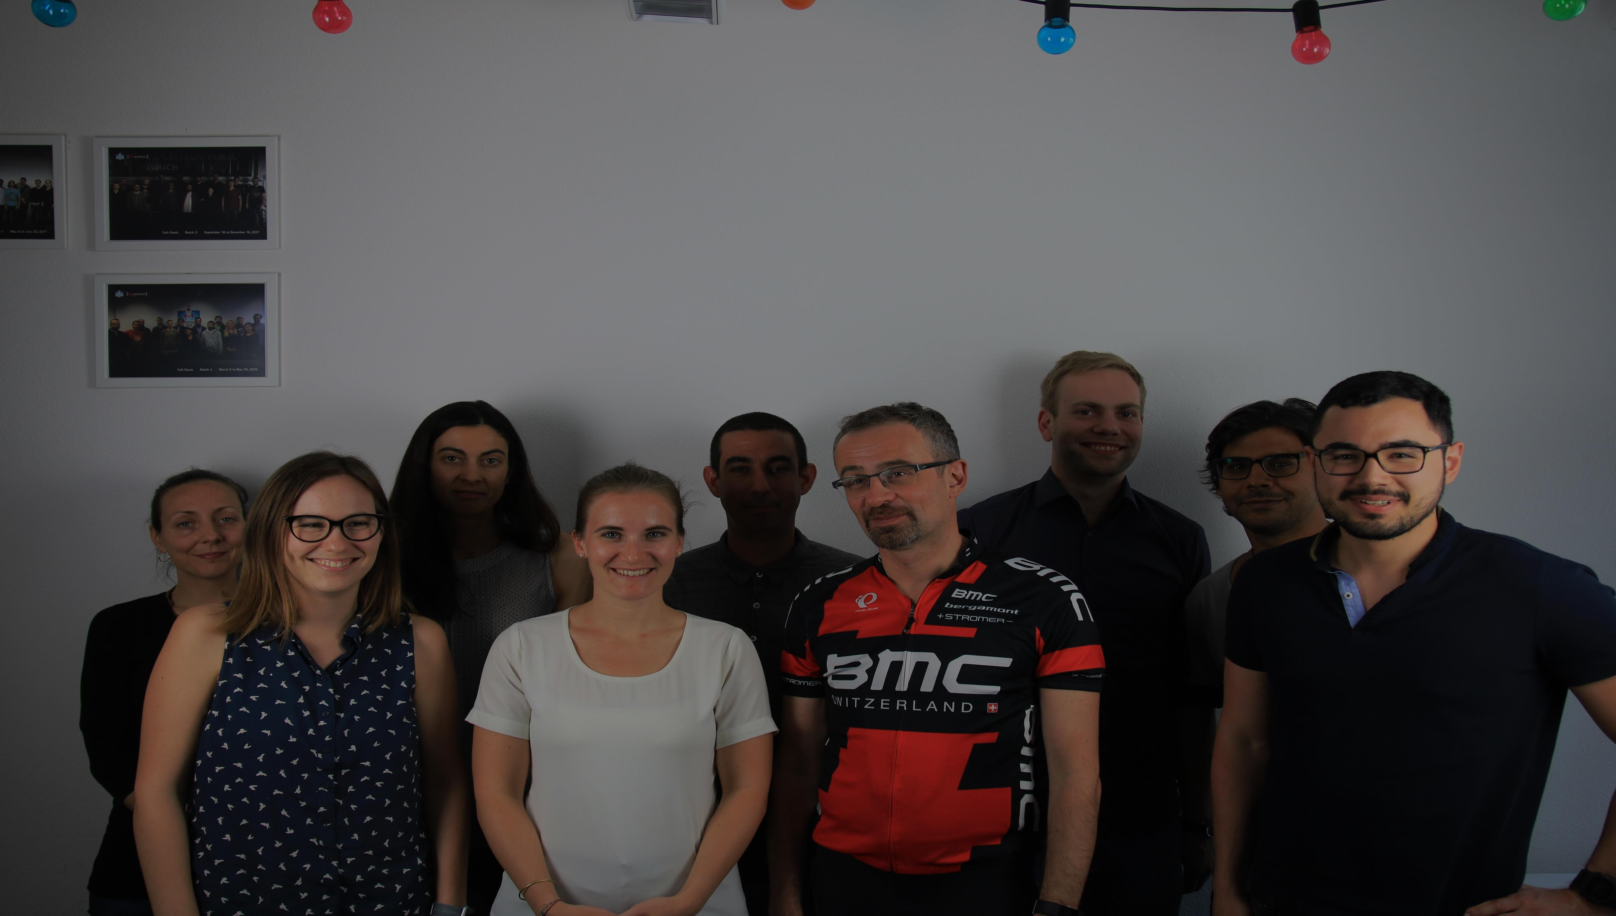


How to differentiate?
Mathieu Stremsdoerfer
July 11, 2018
Mathieu Stremsdoerfer
July 11, 2018
© 2018 Propulsion Academy AG | Technoparkstrasse 1, 8005 Zürich | www.propulsionacademy.com

Slide 2
Your profile and background information.
UP TO NOW
INSEAD MBA in Marketing. ESCP Master in Economics, Technology & Org.
International experience in digital, analytics, market research
Serial entrepreneur and intrapreneur.
Head of pricing and market research at Syngenta Lawn & Garden division
NOW:
Student at Propulsion
FUTURE
Connect data science with business

Slide 3

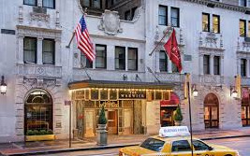



The business model
Flight booking
$ ~3%
38% Direct
27% Referrals Trivago, Tripadvisor
15% Google search
Hotel booking
$$ 10-15%
9% Paid search
7% Mail
Car rental
$ 5%
2% Social
Revenue drivers:
1 Booking rate
2 Package
3 ADR: average daily rate
4 LOS: length of stay
5 Services
Services
$ 5%

Slide 4





The challenge
IT IS GETTING CROWDED OUT THERE…
GOAL:
“Segment hotel booking customers, identify drivers of booking and try to predict booking vs churn”
Scope: US travellers who travel in the US and Rest of the World (ROW)

Slide 5
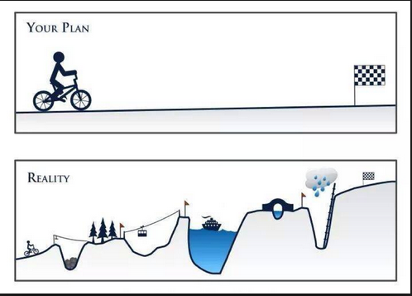
Approach

Slide 6



Approach
1st week
Understand the market
Understand the data
Generate business questions
Create plan
2nd week
Create features, target variable
Clean data as needed, get third party data
Explore new data
Analyze correlations
Learn selenium
Reinstall Anaconda
Learn virtual environments
3rd week
2 days left!!!
Create visualization
Create booking predictions
Time consuming
Learn new tools

Slide 7
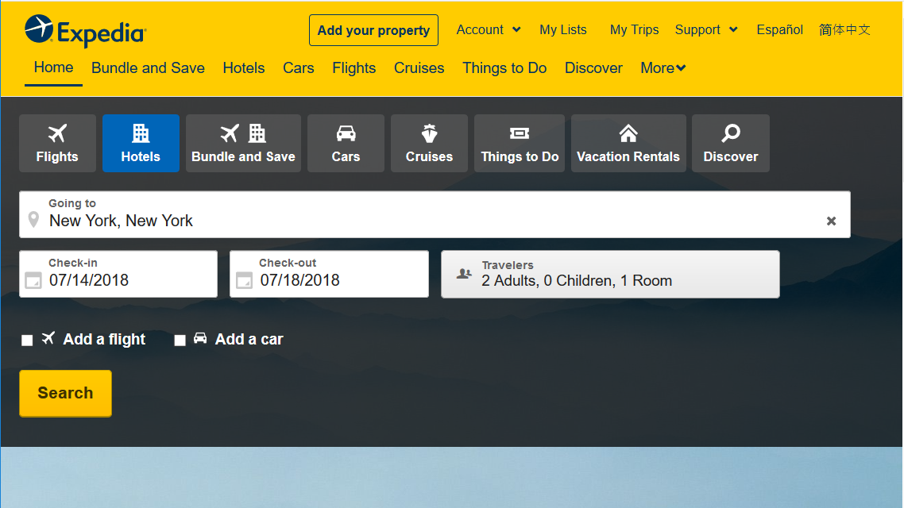
Feature creation: build them from the sites entries
Examples:
Length Of Stay (LOS) = Date check-out – date check-in Booking window (BW) = Date check-in – date searched
Business: = search (1 adult – 0 children during work days and hours) & travel (Monday- Friday) “Bleisure”: search (1 adult – 0 children during work days and hours) & travel (Monday-Sunday)
TOTAL: 35 new features in 9 categories
Notes:
Time & date: 10
Channel: 1
Destination: 3
Hotel: 1: 100 clusters
Revenue drivers: 2

Slide 8
Definition: key binary variables
Booking: for a specific user session, Booking is 1 [hotel booked] or 0 [hotel not booked]
Churn: for a specific user ID, destination (season)
Churn is 1 [sum of Booking = 0] else 0
Prebooking: for a specific user session (season): neither a churn nor a booking ~a visit that will ultimately lead to a booking
Prebooking = 1 - booking - churn
Realized with plotline, ggplot

Slide 9
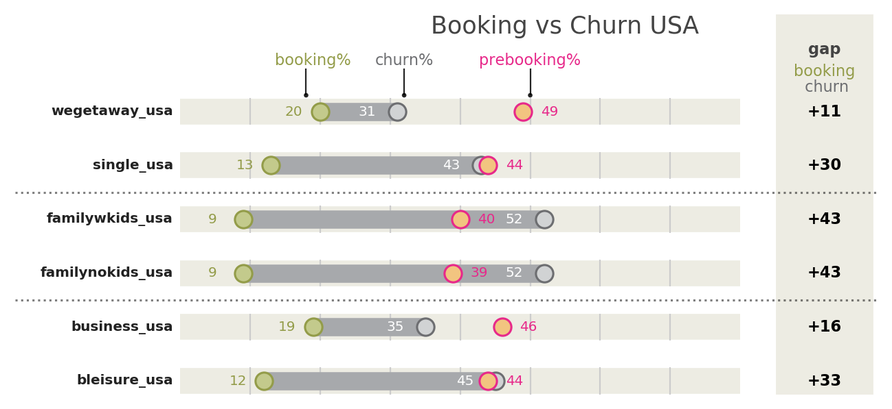

User segments observations
#1: User segments: could merge families into one. Family underperform in booking %
#2: Booking positively correlated with prebooking
Realized with plotline, ggplot

Slide 10
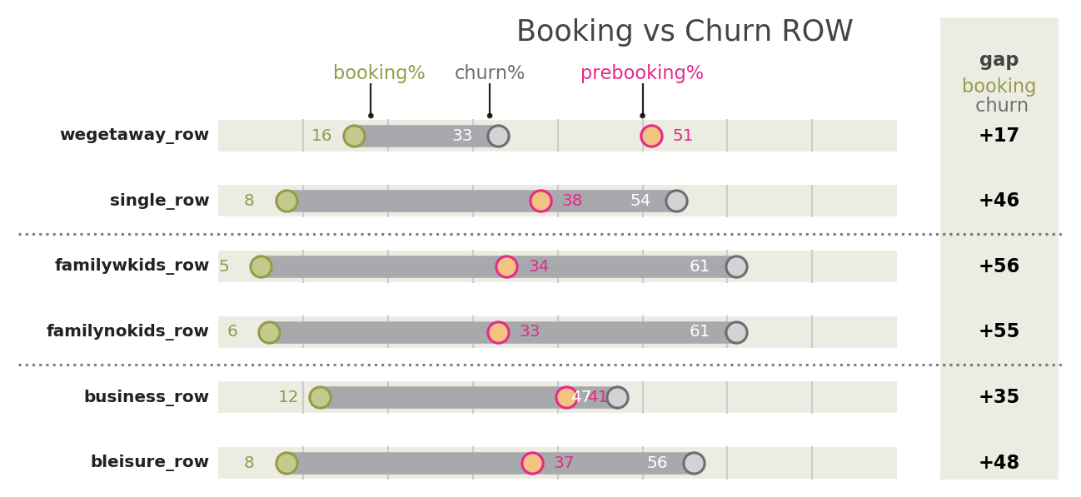
User segments observations
# 3: Same trends as USA, but lower booking rates overall
Realized with plotline, ggplot

Slide 11
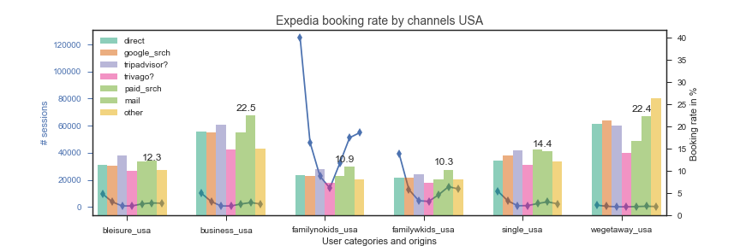
Booking rate by channels and user segments
# 4: Channels: Volume (#1 direct, # 2: Google) ; Booking rate (#1 mail)
# 5: User segments: Volume (# 1 family no kids, # 2 family w kids) ; BR (#1 We getaways)
Realized with matplotlib

Slide 12
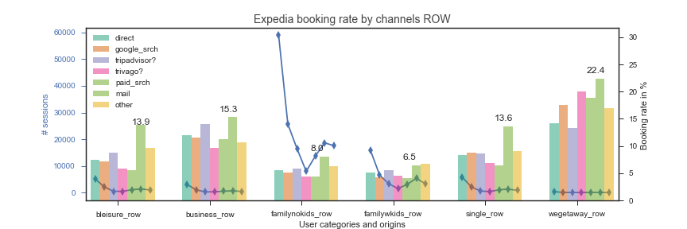
Booking rate by channels and user segments
# 6 traffic ~ ½ of USA
# 7: similar trends as USA
Realized with matplotlib

Slide 13
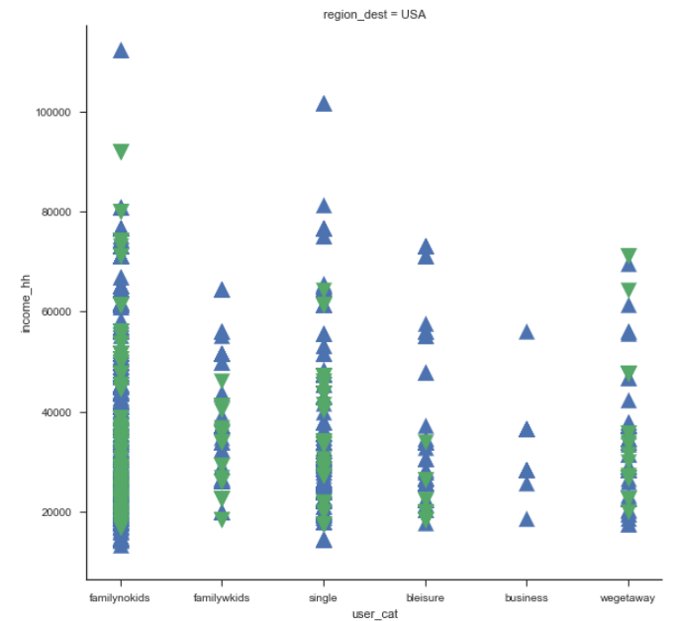
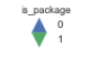
Income sensitivity versus packages
City Household Median Income by origin of travel
USA
$
# 8: Clear opportunities for packages for budget travelers
Opportunity to geo-localize campaigns based on city Household income
100,000
80,000
Is package
No
Yes
60,000
40,000
20,000
Family no kids
Family with kids
Single
Bleisure
Business
W-E getaways
Realized with Seaborn using a random sample with household median income data scrapped

Slide 14
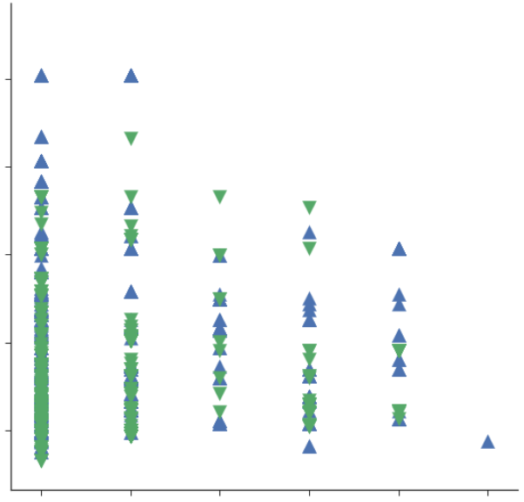
Income sensitivity versus packages
City Household Median Income by origin of travel
ROW
$
100,000
# 9: similar findings for international travellers
80,000
Is package
No
Yes
60,000
40,000
20,000
Note:
Same correlation not found with hotel stars and price bands
Family no kids
Family with kids
Single
Bleisure
Business
W-E getaways
Realized with Seaborn using a random sample with household median income data scrapped

Slide 15

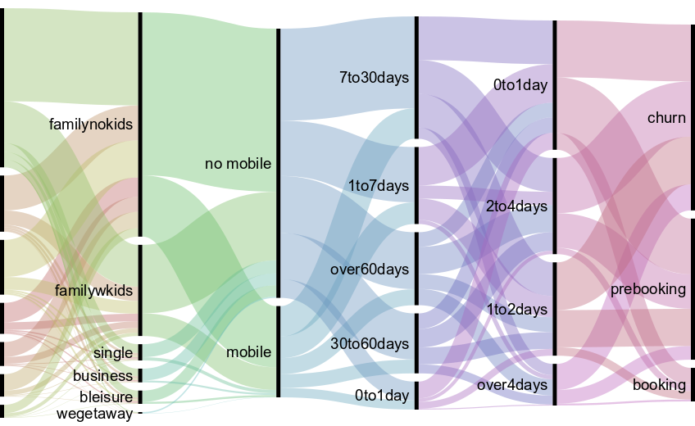
Seasonality effect
USA
Total: 168160
Direct 44%
Tripadvisor 16%
Trivago 15%
Paid search 9%
Google 7%
mail 6%
other 4%
# 10: campaign overspend?
Realized with rawgraphs

Slide 16
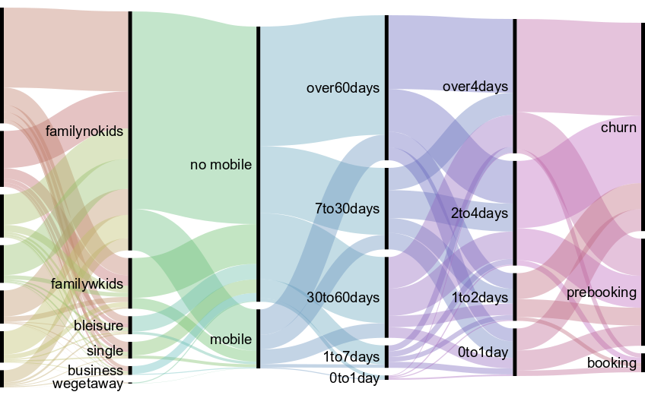
Seasonality effect
# 11 longer planning and trips
ROW
Total: 56957
Google : 35%
Direct:17%
Tripadvisor: 13%
Trivago:11%
Mail:10%
Paid:9%
Other:5%
# 12 prebooking issue
Realized with rawgraphs

Slide 17
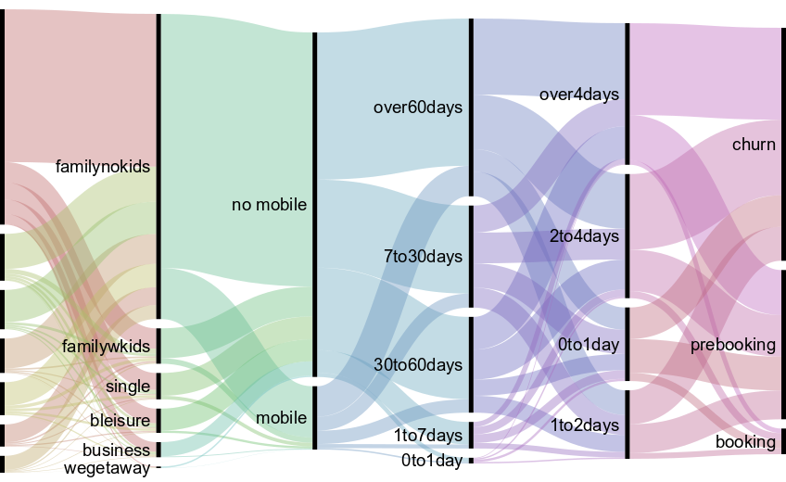
5. Seasonality effect
ROW
Total: 55295
Direct: 53%
Tripadvisor: 11%
Trivago: 10%
Mail: 8%
Paid: 8%
Google: 5%
Other:4%
# 12: campaign overspend?
Realized with rawgraphs

Slide 18
Hotel booking predictions (a work in progress)
Methodological Approach
Business problem
We want to predict if a user will churn, prebook, or book in a given season
Definition of the problem
A supervised –multi class classification problem with imbalanced classes and mixed variables (binary, numeric, categorical) with time series data
Preparation
Divide dataset into four seasons
Split train and test
Feature selection (kstratified folds, Man Whitney , collinearity, ridge regression)
Modelling: Logistic regression, KNN, Random Forest, Naïve Bayes, SVM, Gradient Boost,

Slide 19
Conclusions:
Quick win:
Define user categories and session features per season to better understand needs
Geo target campaigns based on IP/income – user categories
Increase mobile offerings for last minute bookings
Tactical:
Investigate Expedia seasonal campaign spent for possible optimization
Use booking/churn/prebooking prediction to identify “real churn” and offer help and attractive offers
Strategic:
Investigate root causes of low prebooking and BR for family and ROW
ex: is Expedia hotel offering adequate for families?
ex: should Expedia develop planning tools for ROW travelers?
Notes:
Investigates drivers of prebooking on multi season data (link with loyalty?)

Slide 20
Outlook
To go further:
Complete multiclass classification
Inquire user category stability over time and user loyalty
Price data (quantitative) and multi year would be helpful for predictions
Perspective: marketing themes also applicable to other businesses:
Fit for purpose segmentation
Traffic drivers - channels
Conversion efficiency: churn vs booking vs prebooking
Price sensitivity - geo localization
Seasonality
Local vs international
Campaign spend efficiency

Slide 21






Thank you!
Mathieu Stremsdoerfer
mstrems@gmail.com
www.linkedin.com/in/mstrems/

Slide 22
APPENDIX

Slide 23
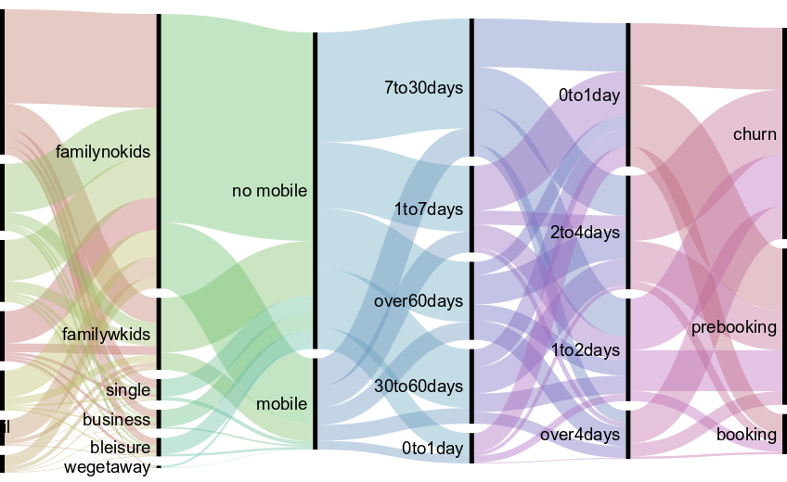
Seasonality effect
USA
Total: 121379
Google 36%
Trivago16%
Tripadvisor 15%
Direct 12%
Paid search 10%
Mail 6%
Other 4%
Realized with rawgraphs
Notes:
: Spring (March 1st-May 30th)- “Sankey diagram”

Slide 24
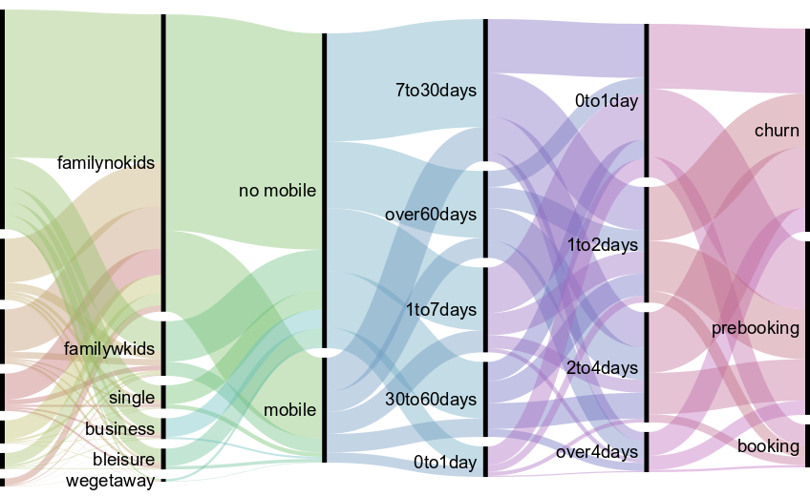
Seasonality effect
USA
Total 127683
Direct 52%
Tripadvisor 15%
Trivago 13%
Paid search 9%
Mail 5%
Other 4%
Google 2 %
# 10: campaign overspend?
Realized with rawgraphs

Slide 25
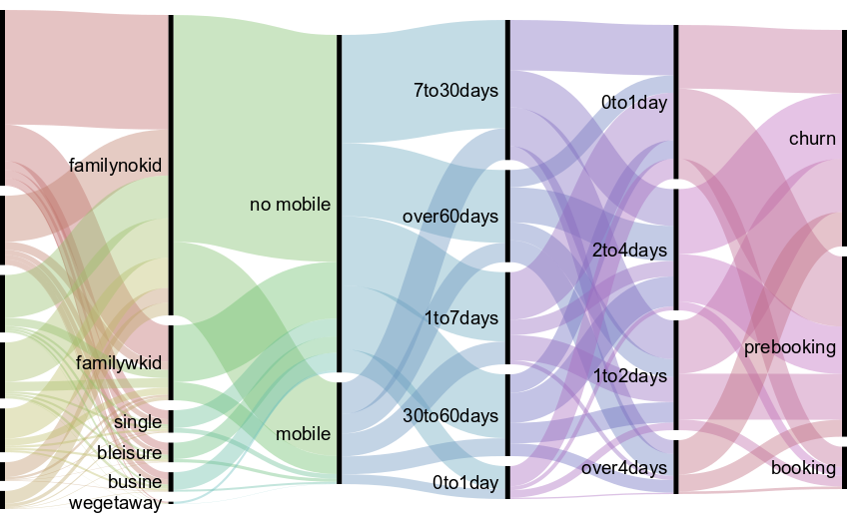
Seasonality effect
USA
Total: 102471
Direct: 40%
Google : 16%
Trivago: 13%
Tripadvisor:13%
Paid search: 10%
Mail: 4%
Other:4%
Realized with rawgraphs

Slide 26
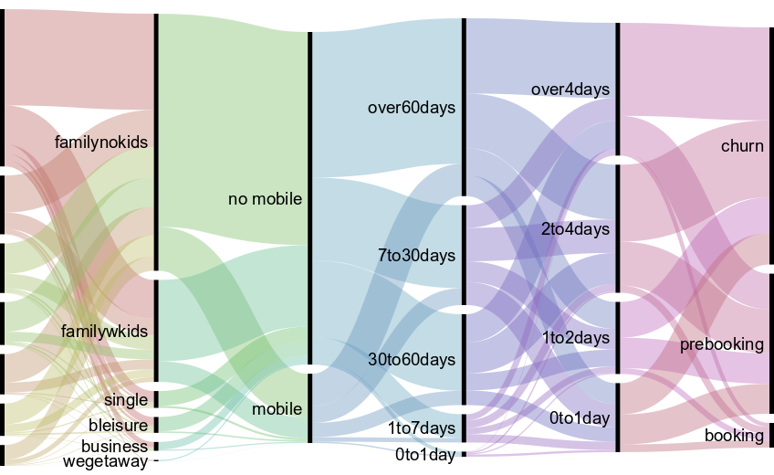
Seasonality effect
ROW
Total: 72335
Direct: 39%
Google:15%
Tripadvisor:12%
Trivago: 11%
Mail:10%
Paid:8%
Other:5%
Realized with rawgraphs

Slide 27
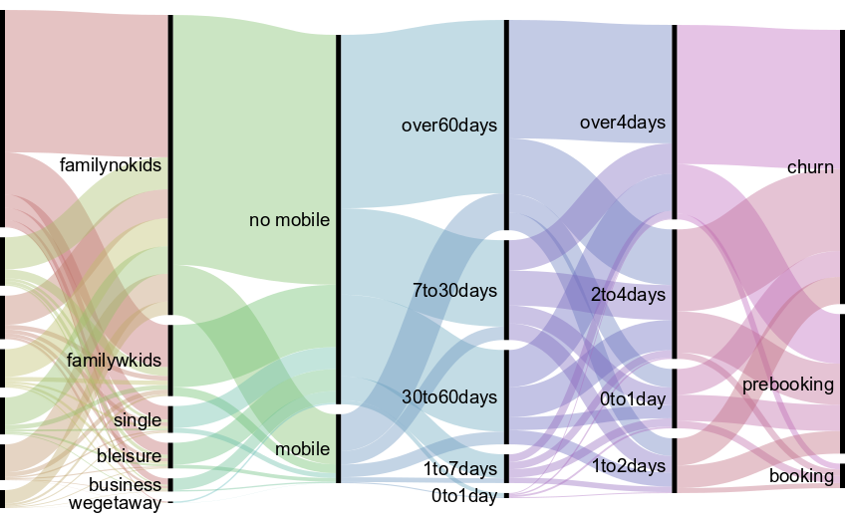
Seasonality effect
ROW
Total: 44792
Direct: 50%
Tripadvisor: 11%
Google:10%
Paid:9%
Trivago:8%
Mail:8%
Other:4%
Realized with rawgraphs

